Slide 1
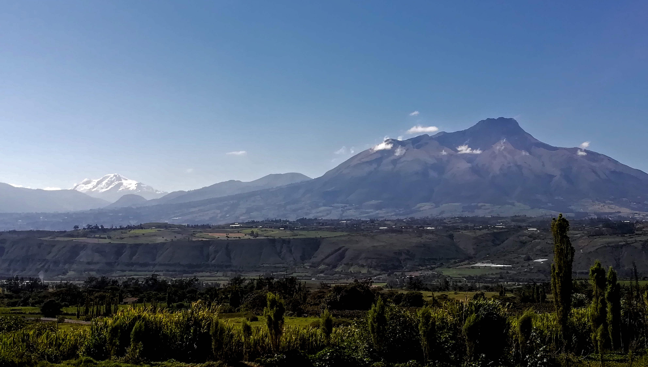
SEMINARIO BREVE
Volcanic landslides in Ecuador and the controversial case of the Cubilche debris avalanche deposit in northern Andes.
Dr. Matteo Roverato
YachayTech University, Urcuquí, Ecuador
4 Aprile 2018, ore 14.30
Aula Ruffini - Via Valperga Caluso 35, Torino

